Slide 1
FAKE NEWS PREDICTION
Submited By:
Sayan Kumar Bhunia

Slide 2
OUTLINE
Introduction
Problem statement
Project Specification
Dataset
Data Cleaning
Feature Engineering
Outlier Detection
Feature scaling
Stemming
tfidfvectorizer
Model Creation
Key metrics
Conclusion

Slide 3
INTRODUCTION
Fake news has become one of the biggest problems of our age. It has serious impact on our online as well as offline discourse. One can even go as far as saying that, to date, fake news poses a clear and present danger to western democracy and stability of the society.
Classification algorithm is used to create a model with a great accuracy score.

Slide 4
PROBLEM STATEMENT
Fake news's simple meaning is to incorporate information that leads people to the wrong path. Nowadays fake news spreading like water and people share this information without verifying it. This is often done to further or impose certain ideas and is often achieved with political agendas.
For media outlets, the ability to attract viewers to their websites is necessary to generate online advertising revenue. So it is necessary to detect fake news.

Slide 5
PROJECT SPECIFICATION
Machine learning data only works with numerical features so we have to convert text data into numerical columns. So we have to preprocess the text and that is called natural language processing.
In-text preprocess we are cleaning our text by stemming, lemmatization, remove stopwords, remove special symbols and numbers, etc. After cleaning the data we have to feed this text data into a vectorizer which will convert this text data into numerical features.

Slide 6
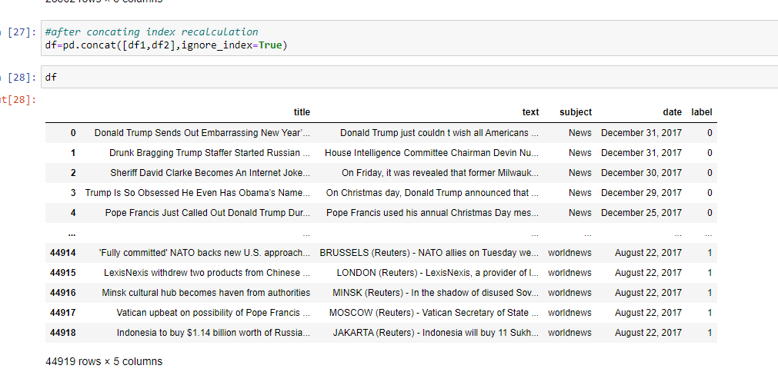
DATASET
There are two datasets one for fake news and one for true news. In true news, there is 21417 news, and in fake news, there is 23481 news. I have to insert one label column zero for fake news and one for true news. I have combined both datasets using pandas built-in function concat.

Slide 7
DATA CLEANING
The main aim of Data Cleaning is to identify and remove errors &
duplicate data, in order to create a reliable dataset.
The process of data cleaning is done by usinga very famous library pandas.
Initially, those columns/features are dropped from dataset which are not important for prediction..
The rows having a null value in any colurnns are dropped from dataset.
The columns having characters as well as integer values are converted into integer values only.
Many more data cleaning techniques are used to improve the quality of dataset.

Slide 8
FEATURE ENGINEERING
Feature engineering is the process of using domain knowledge to extract features from raw data via data mining techniques. These features can be used to improve the performance of machine learning algorithms. Feature engineering can be considered as applied machine learning itself.
Dimensionality reduction techniques are used in dataset to reduce those rows which are not very much important for predicting target value.

Slide 9
OUTLIER DETECTION
In simple words, an outlier is an observation that diverges from an overall pattern on a sample.
There are many types of outlier detection techniques such as Z-Score or Extreme Value Analysis, Probabilistic and Statistical Modeling, Information Theory Models, Standard Deviation etc.
In the following case no need to detect outliers as we have only two columns.

Slide 10
STEMMING
Stemming is a natural language processing technique that lowers inflection in words to their root forms, hence aiding in the preprocessing of text, words, and documents for text normalization.
PorterStemmer() is a module in NLTK that implements the Porter Stemming technique.

Slide 11
TFIDFVECTORIZER
Tf-idf stands for Term Frequency Inverse Document Frequency of records. It can be defined as the calculation of how relevant a word in a series or corpus is to a text. The meaning increases proportionally to the number of times in the text a word appears but is compensated by the word frequency in the corpus (data-set).

Slide 12
FEATURE SCALING
Feature Scaling ensures that all features will get equal importance in supervised classifier models. Standard scaler was used to scale all features in the data.

Slide 13
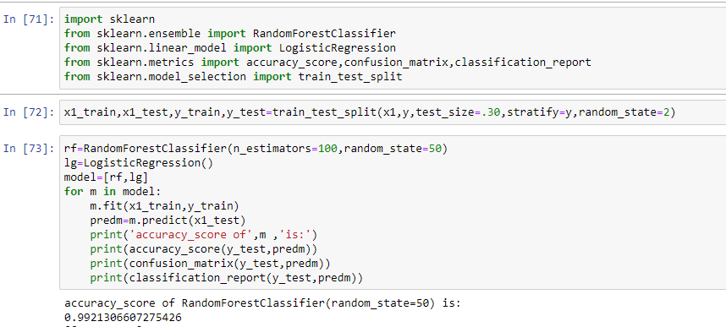
MODEL CREATION
The process of modeling means training a machine learning algorithm to predict the labels from the features.
We have used Random Forest Classifier algorithm for training and testing of the model.
The accuracy rate of our model is 99% which is pretty good.

Slide 14

KEY METRICS
Selection of a model requires evaluation and evaluation requires a good metric. This is indeed important. If we optimize a model based on incorrect metric, then, our model might not be suitable for the business goals.
We have a number of metrics, for example, accuracy, recall, precision, F1 score, area under receiver operating characteristic curve, to choose from.

Slide 15
CONCLUSION
Key aspects of building successful classifier are:
Selecting correct data according to the purpose or problem statement.
Proper processing and understanding of the data
Selecting the model and optimizing the model.
I have used tfidfvectorizer for convert object data type into int datatype as machine doesn’t understand object type data.
Stemming is used to find root word.
I have used three Classification model and found Random Forest Classifier to be the best fit. It is giving 99% accuracy.

Slide 16
THANK YOU

